Slide 1
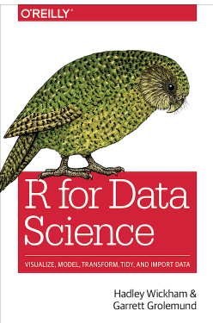
Chapters 10 Tibbles Follow along here: https://r4ds.had.co.nz/tibbles.html
Source:https://r4ds.had.co.nz/

Slide 2
10 Tibbles
Tibbles
In the Tidyverse, we will often use tibbles instead of traditional data.frames.
Tibbles include features that make life a little easier. The R Studio team calls them “opinionated data frames.”
The added functionality of tibbles comes through the use of the tibble package.
Building a package in R adds functionality, without breaking the existing code.

Slide 3
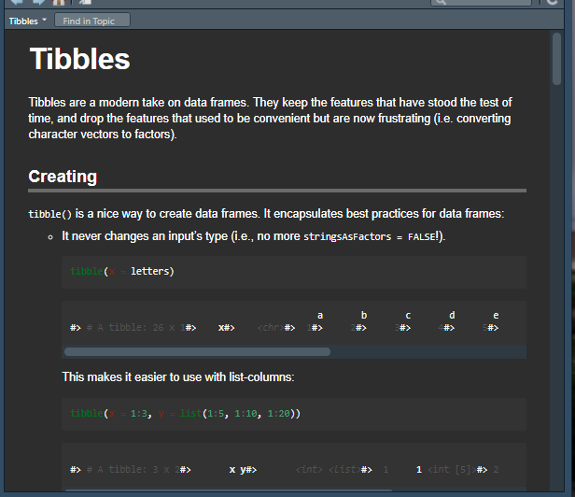
10 Tibbles
Tibbles
library(tidyverse)
vignette(“tibble”)

Slide 4
10 Tibbles
10. 2 Creating Tibbles
Tibbles are a unifying feature of the Tidyverse (ggplot2, dplyr, tidyr, readr, purr, tibble, stringr, and forcats)
Most other packages use traditional data frames, so you my need to force a data frame to a tibble by using as.tibble

Slide 5
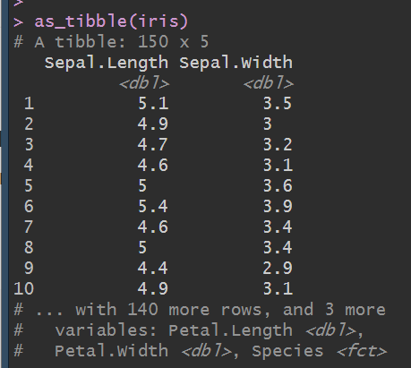
10 Tibbles
10. 2 Creating Tibbles
as_tibble(iris)

Slide 6
10 Tibbles
10. 2 Creating Tibbles
You can also create a new tibble from individual vectors with tibble(). This will automatically recycle inputs of length 1, and allows you to refer to variables that you just created, as shown below.

Slide 7
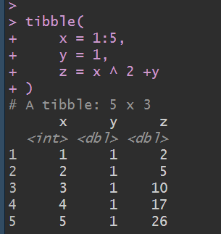
10 Tibbles
10. 2 Creating Tibbles

Slide 8
10 Tibbles
10. 2 Creating Tibbles
-If you’re already familiar with data,frame(), tibble() does much less:
it never changes the type of the inputs (e.g. it never converts strings to factors!)
it never changes the names of variables
it never creates row names

Slide 9
10 Tibbles
10. 2 Creating Tibbles
It’s possible for a tibble to have column names that are not valid R variable names, aka non-syntactic names.
For example, they might not start with a letter, or they might contain unusual characters like a space.
To refer to these variables, you need to surround them with backticks

Slide 10
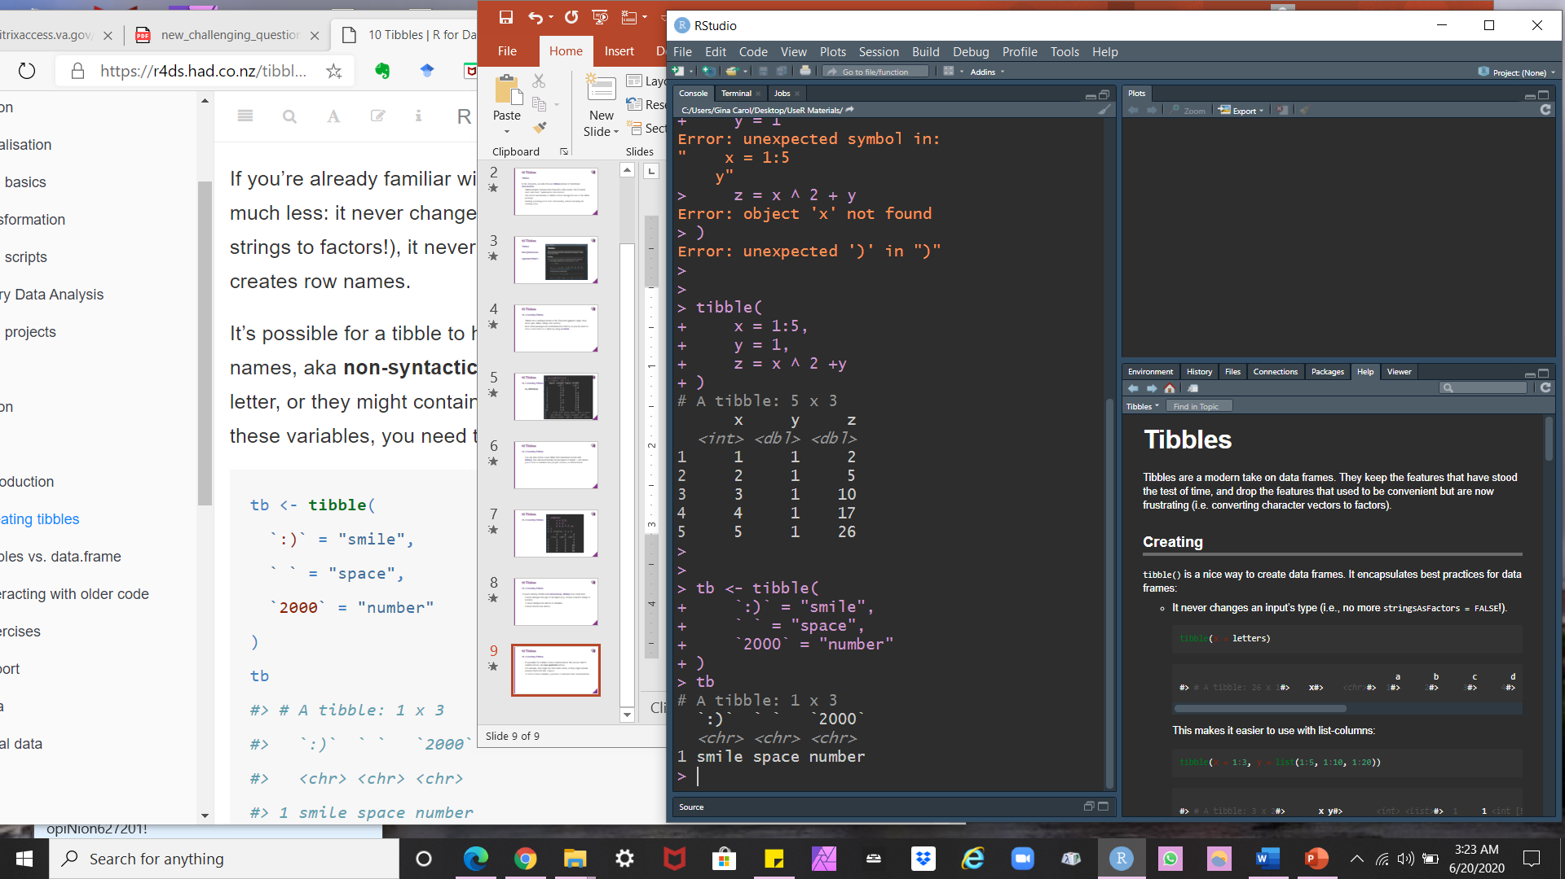
10 Tibbles
10. 2 Creating Tibbles

Slide 11
10 Tibbles
10. 2 Creating Tibbles

Slide 12
10 Tibbles
10. 2 Creating Tibbles
You’ll also need the backticks when working with these variables in other packages, like ggplot2, dplyr, and tidyr.
Another way to create a tibble is with tribble(), short for transposed tibble.
tribble() is customized for data entry in code…
column headings are defined by formulas (i.e. they start with ~
entries are separated by commas.
This makes it possible to lay out small amounts of data in easy to read form.

Slide 13
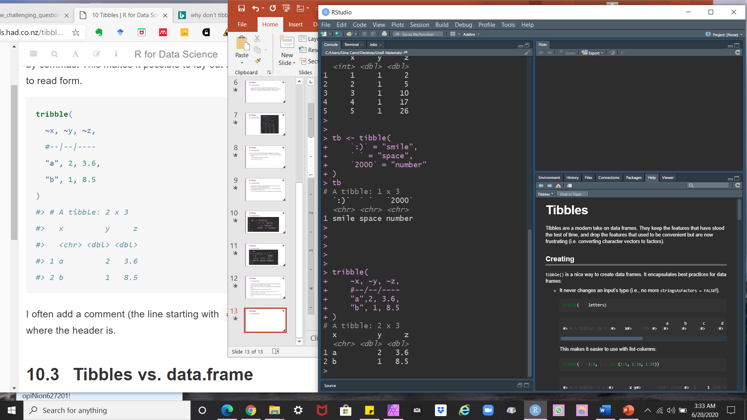
10 Tibbles
10. 2 Creating Tibbles

Slide 14
10 Tibbles
10. 2 Creating Tibbles

Slide 15
10 Tibbles
10. 3 and 10.3.1 Tibbles v. data.frame, and Printing
- There are two main differences in the usage of a tibble vs. a classic data.frame: printing and subsetting.
Tibbles have a refined print method that shows only the first 10 rows, and all the columns that fit on screen.
This makes it much easier to work with large data.

Slide 16
10 Tibbles
10. 3 and 10.3.1 Tibbles v. data.frame, and Printing
In addition to its name, each column reports its type, a nice feature borrowed from str():

Slide 17
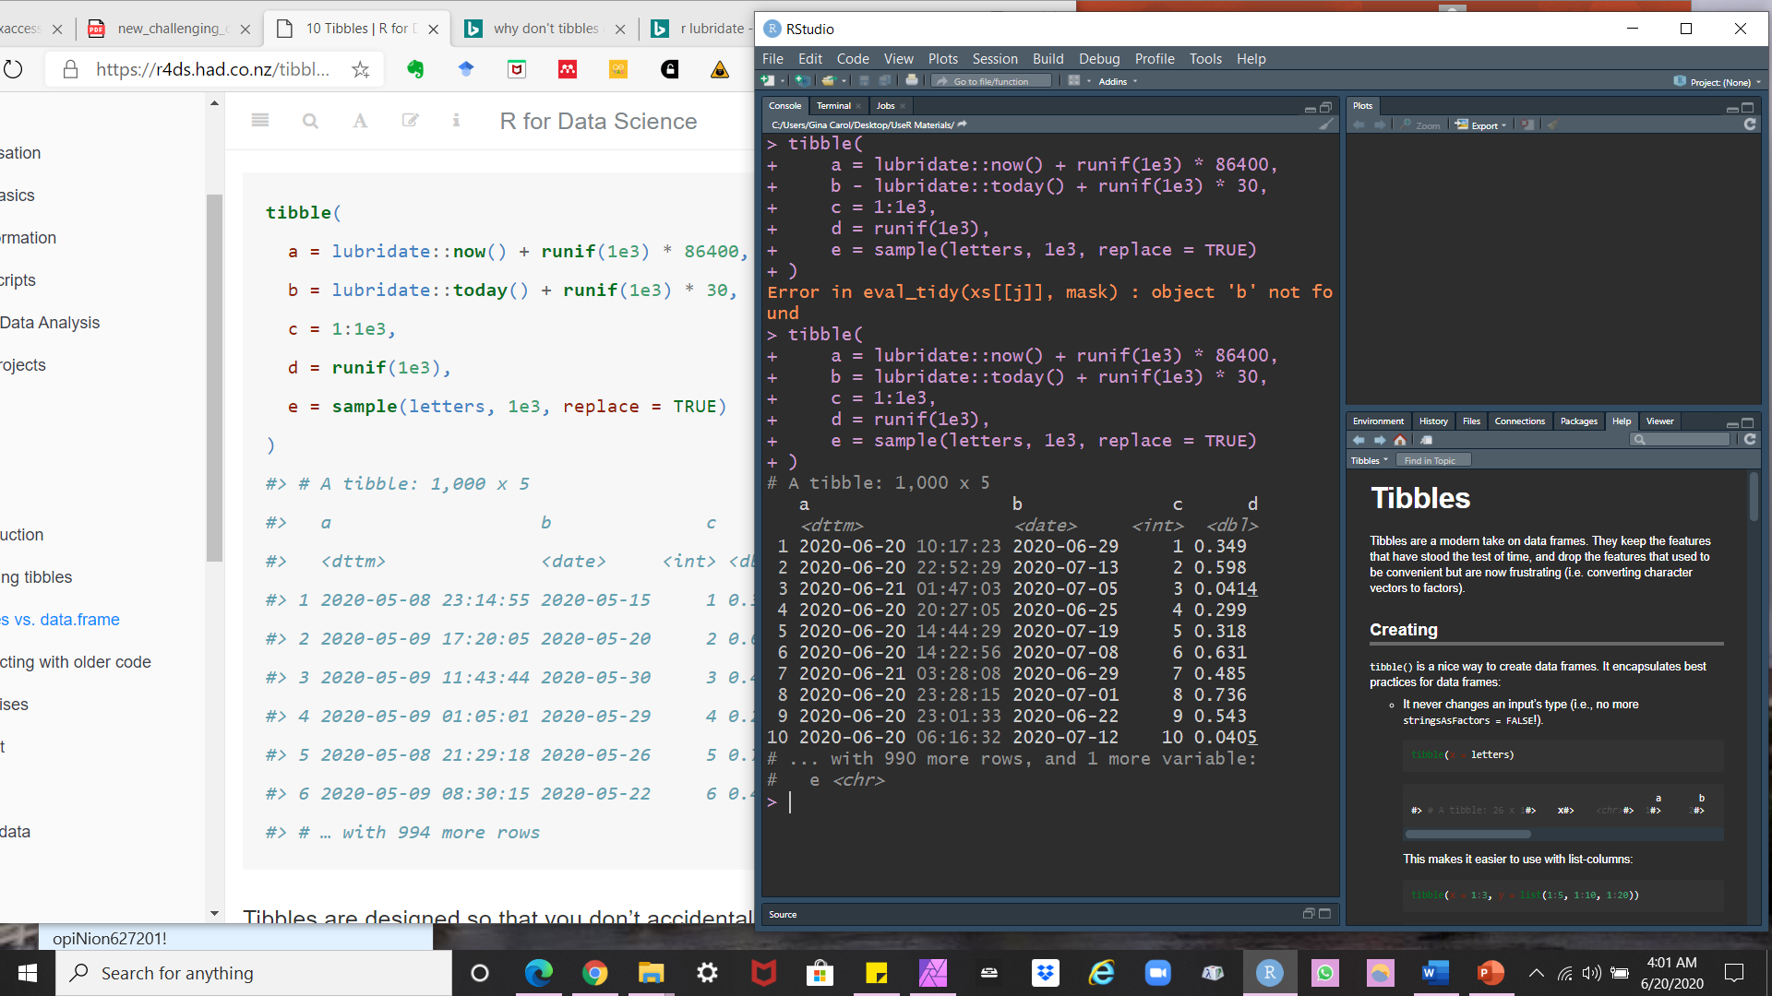
10 Tibbles
10. 3 and 10.3.1 Tibbles v. data.frame, and Printing

Slide 18
10 Tibbles
10. 3 and 10.3.1 Tibbles v. data.frame, and Printing

Slide 19
10 Tibbles
10. 3 and 10.3.1 Tibbles v. data.frame, and Printing
Tibbles are designed so that you don’t accidentally overwhelm your console when you print large data frames.
But sometimes you need more output than the default display. There are a few options that can help.
First, you can explicitly print() the data frame and control the number of rows (n) and the width of the display.
width = Inf will display all columns.

Slide 20
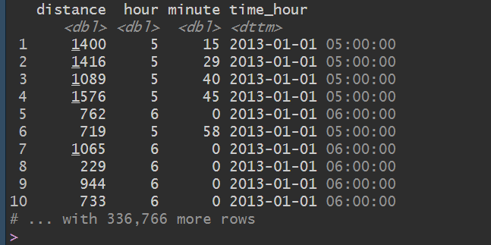
10 Tibbles
10. 3 and 10.3.1 Tibbles v. data.frame, and Printing
install.packages("nycflights13")

Slide 21
10 Tibbles
10. 3 and 10.3.1 Tibbles v. data.frame, and Printing
You can also control the default print behavior by setting options:
Options(tibble.print_max = n, tibble.print_min = m) Means, “ if there are more than n rows, print only the first m rows.”
Use options (tibble.print_max = Inf) to always show all rows.
options (tibble.width = Inf) will always print all columns, regardless of the width of the screen.

Slide 22
10 Tibbles
10. 3 and 10.3.1 Tibbles v. data.frame, and Printing
You can see a complete list of options by looking at the package help with package?tibble.

Slide 23
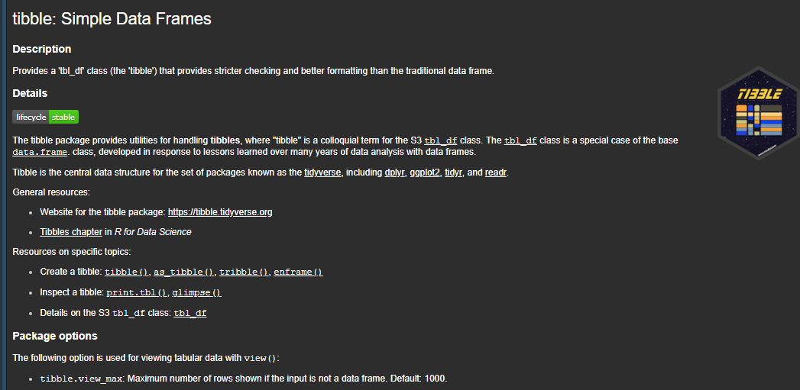
10 Tibbles
10. 3 and 10.3.1 Tibbles v. data.frame, and Printing

Slide 24
10 Tibbles
10. 3 and 10.3.1 Tibbles v. data.frame, and Printing
A final option is to use RStudio’s built-in data viewer to get a scrollable view of the complete dataset.
This is also often useful at the end of a long chain of manipulations.

Slide 25
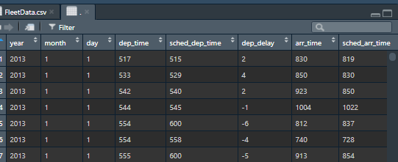
10 Tibbles
10. 3 and 10.3.1 Tibbles v. data.frame, and Printing
nycflights13::flights %>% + View()

Slide 26
10 Tibbles
10. 3.2 Subsetting
So far all the tools you’ve learned have worked with complete data frames.
If you want to pull out a single variable, you need some new tools, $ and [[.
[[ can extract by name or position.
$ only extracts by name but is a little less typing.

Slide 27
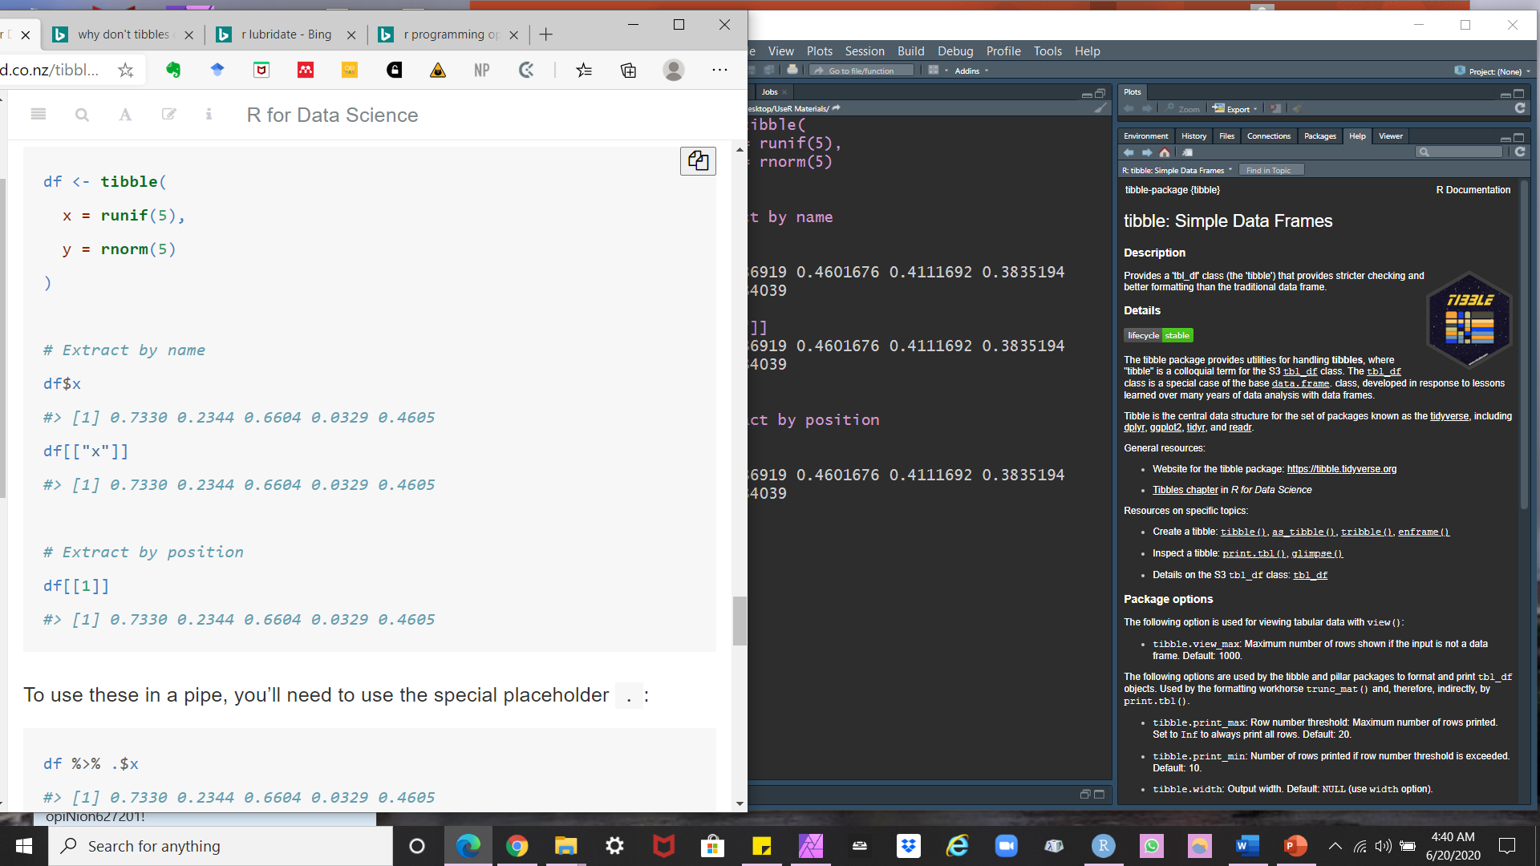
10 Tibbles
10. 3.2 Subsetting

Slide 28
10 Tibbles
10. 3.2 Subsetting

Slide 29
10 Tibbles
10. 3.2 Subsetting

Slide 30
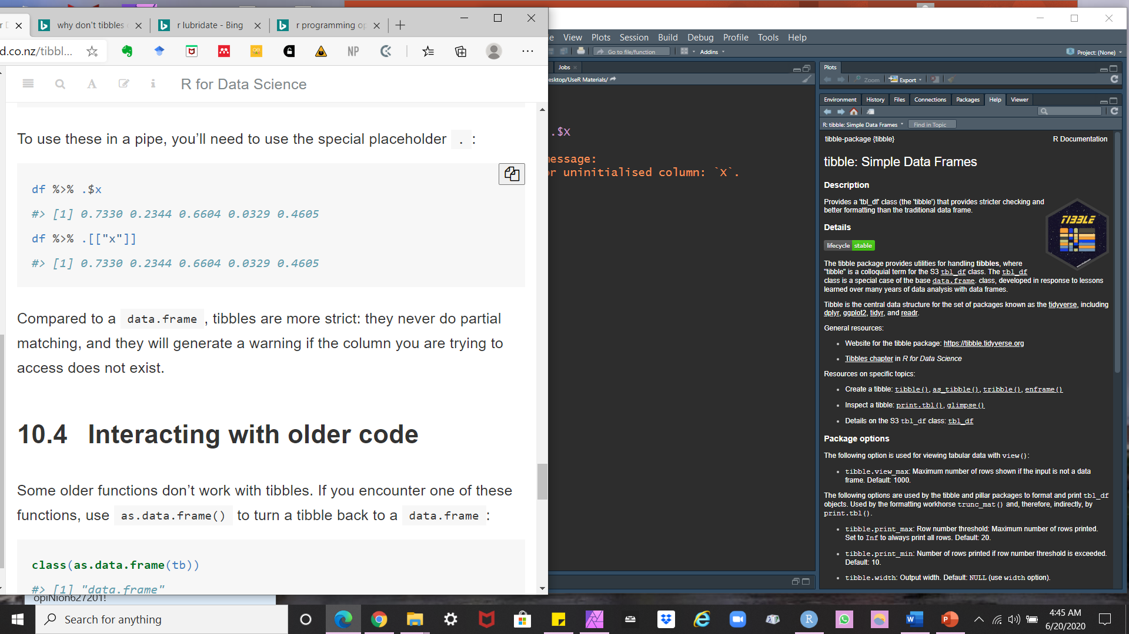
10 Tibbles
10. 3.2 Subsetting
To use these in a pipe, you’ll need to use the special placeholder .

Slide 31
10 Tibbles
10. 3.2 Subsetting
Compared to a data.frame, tibbles are more strict.
They never do partial matching.
And they will generate a warning if the column you are trying to access does not exist.

Slide 32
10 Tibbles
10.4 Interacting with older code
Some older functions don’t work with tibbles.
If you encounter one of these functions, use as.data,frame() to turn a tibble back to a data.frame.
> class(as.data.frame(tb)) [1] "data.frame"

Slide 33
10 Tibbles
10.4 Interacting with older code
The main reason that some older functions don’t work with tibble is the [ function.
We don’t use [ much in this book because dplyr::filter() and dplyr::select() allow you to solve the same problems with clearer code.
With base R data frames, sometimes returns a data frame, and sometimes returns a vector.
With tibbles, [ always returns another tibble.

